Slide 1
Samsung QuickShare Project

Slide 2
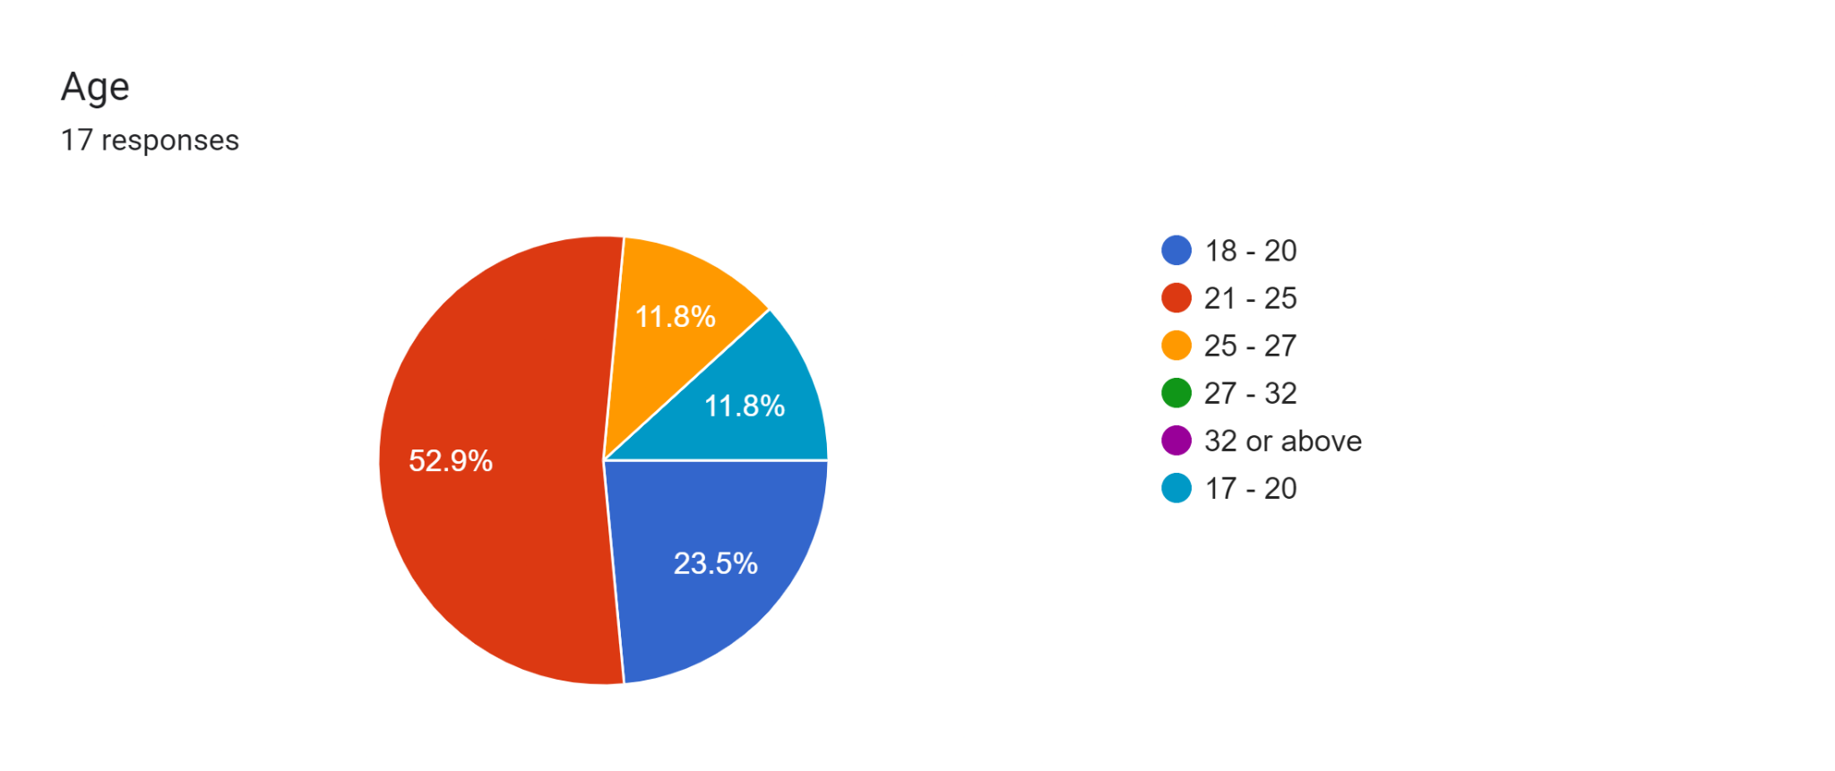
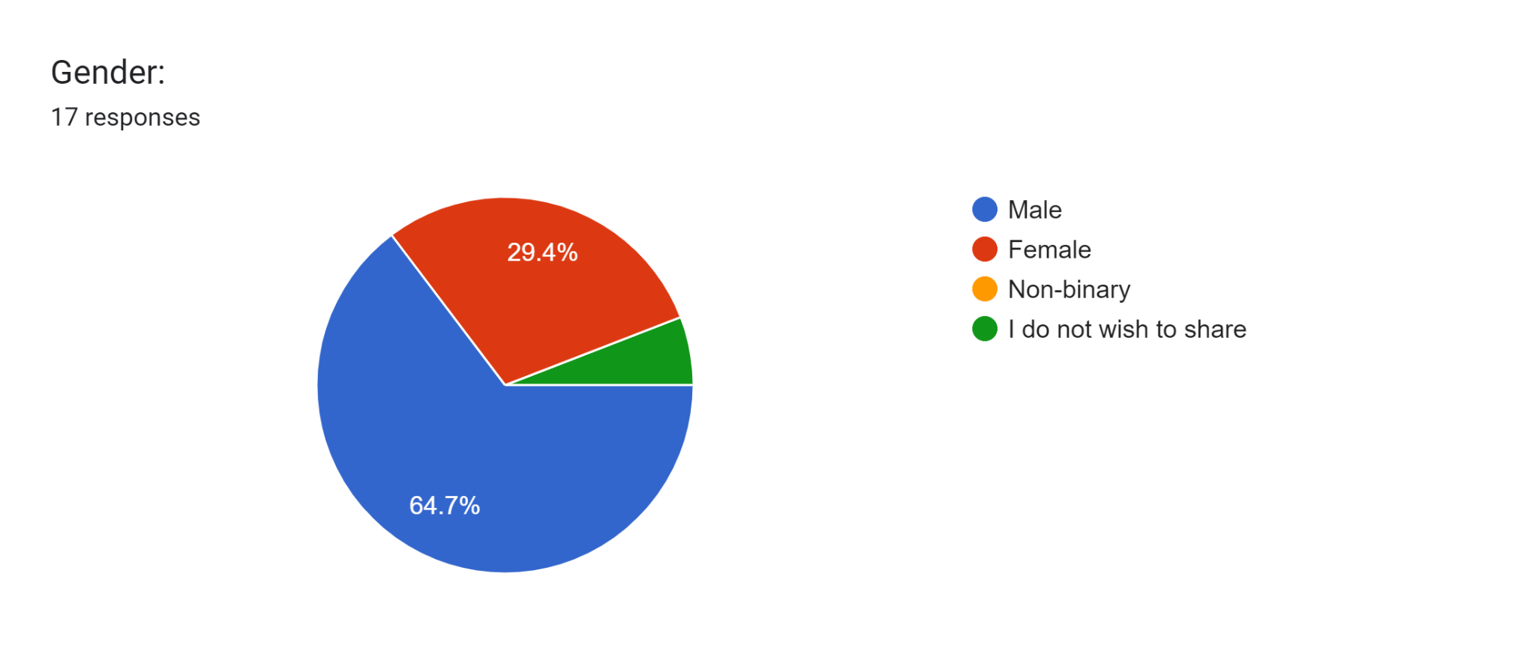

Slide 3
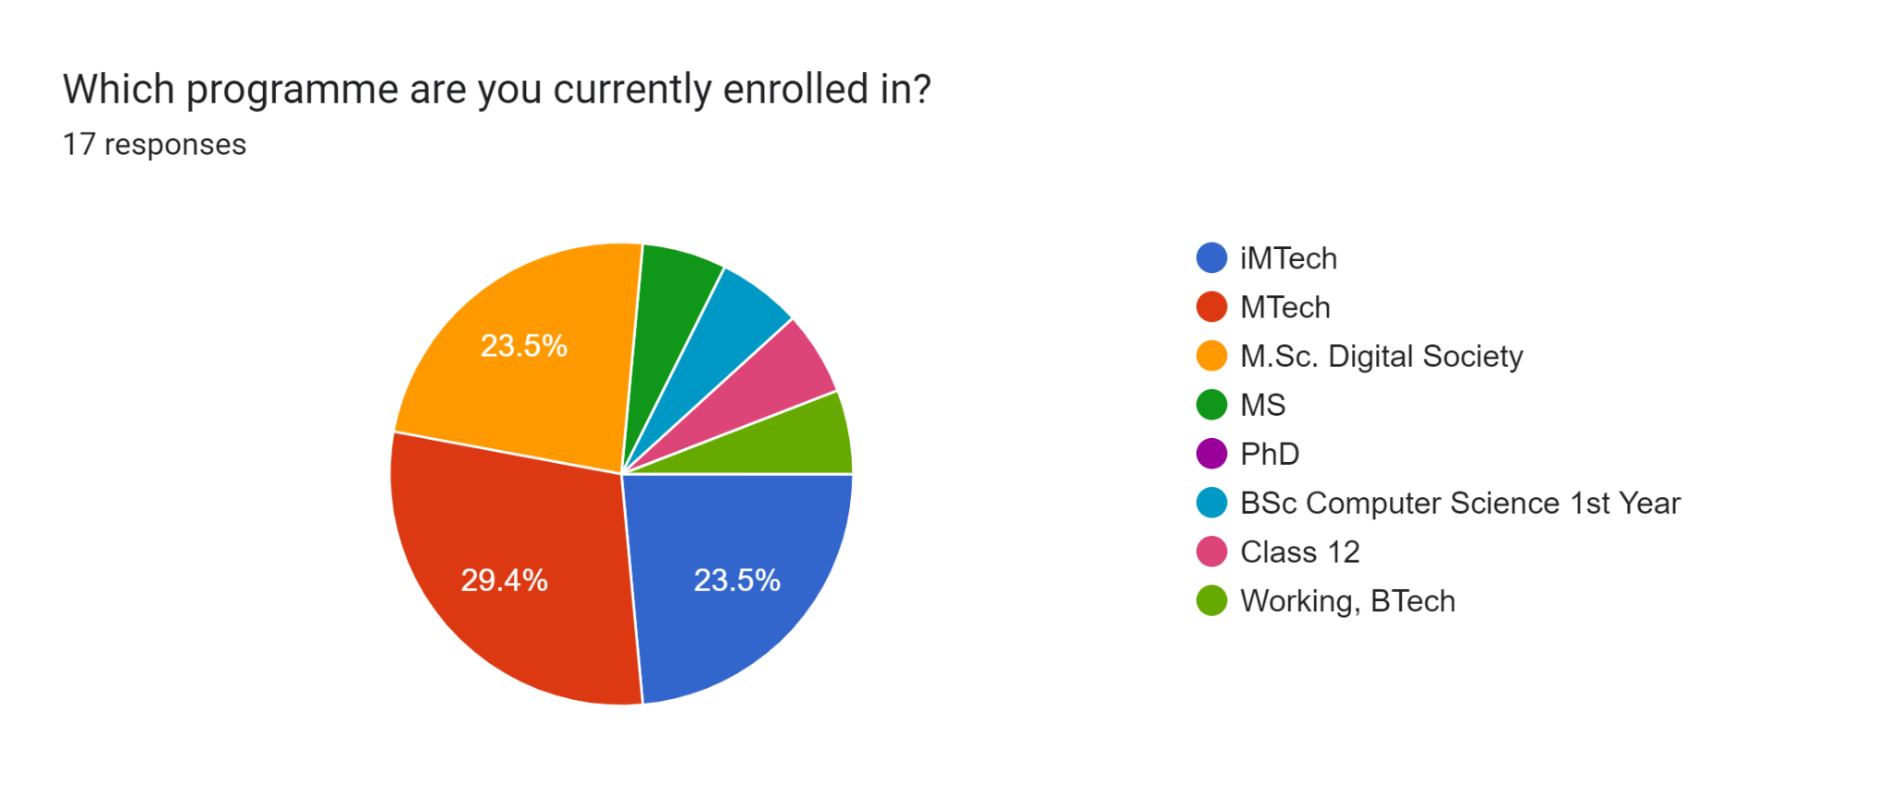
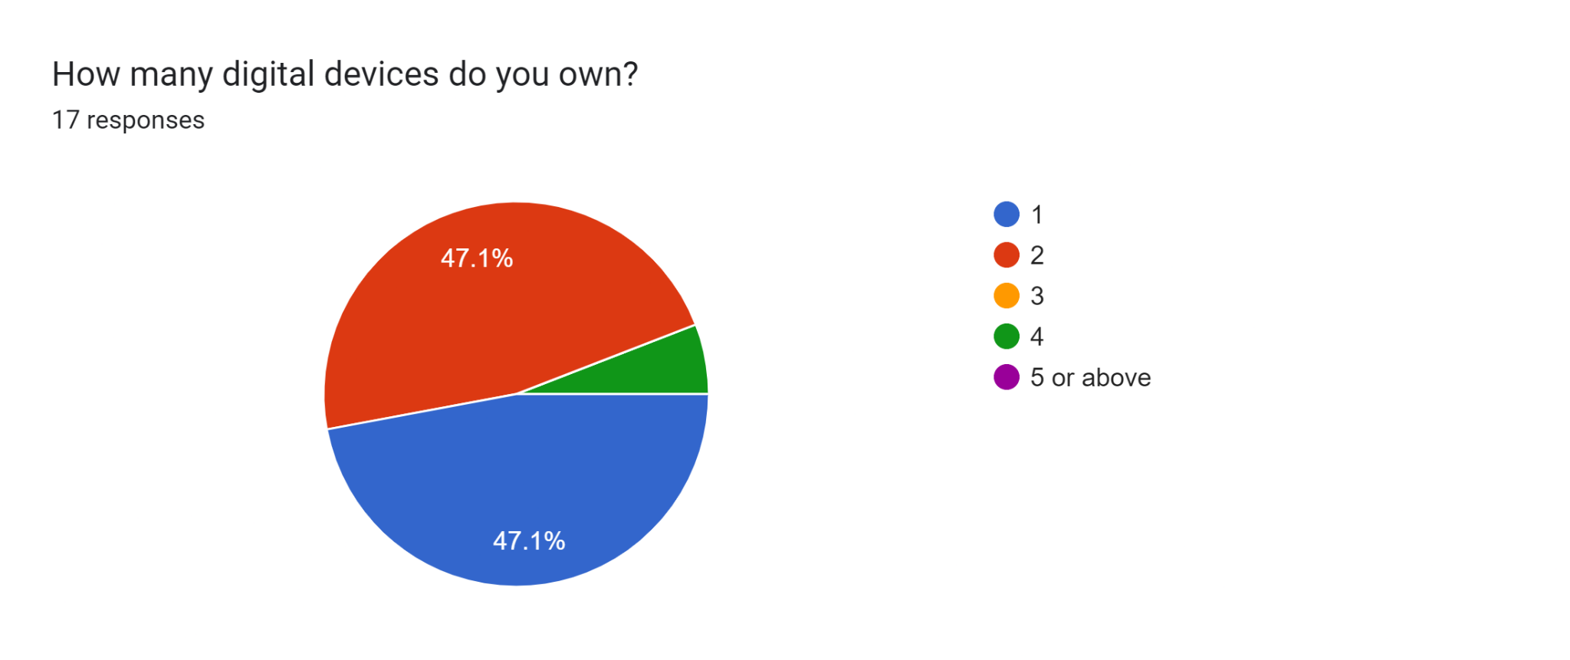

Slide 4
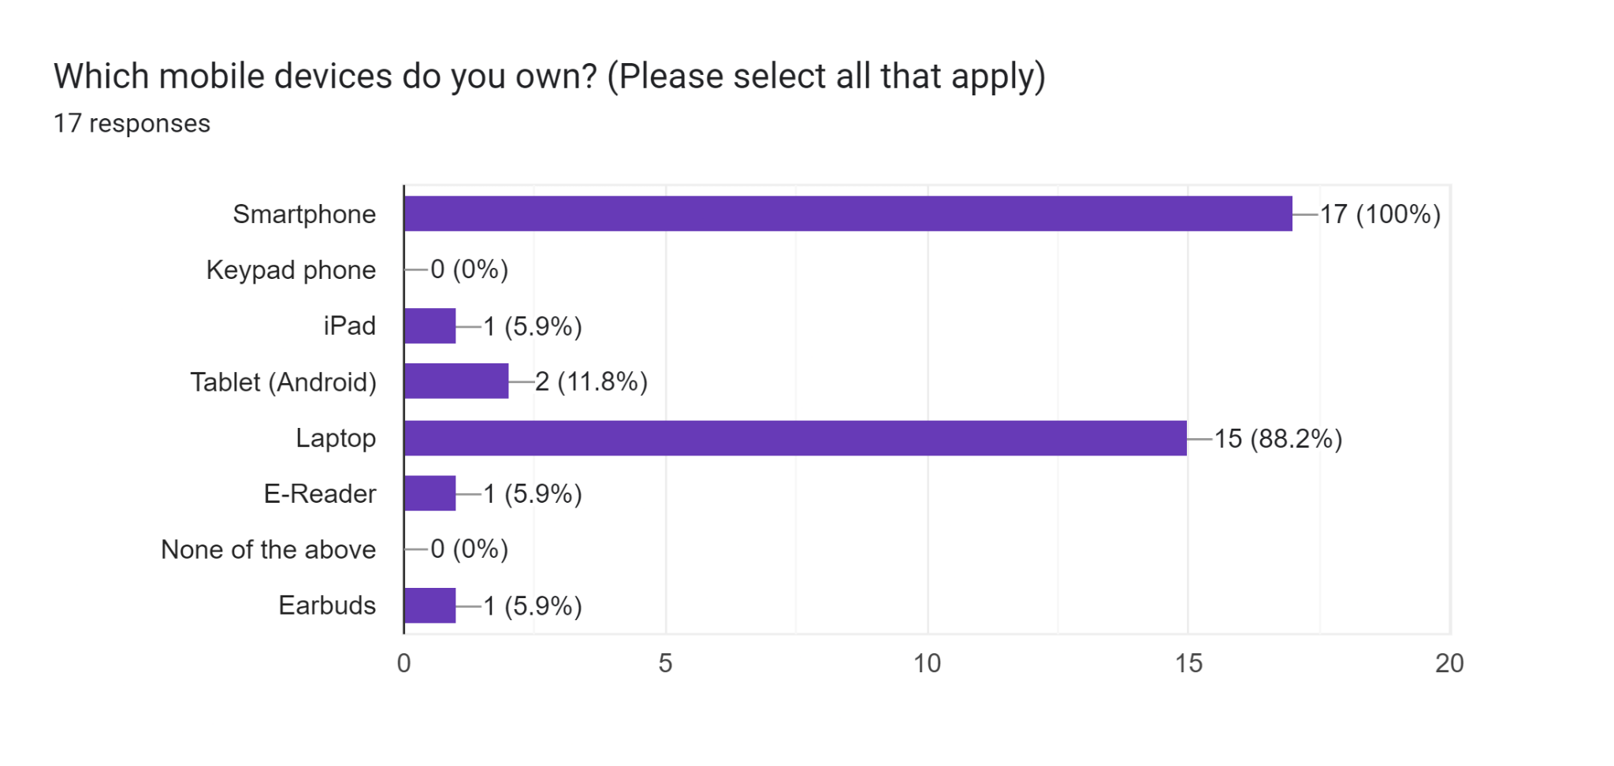
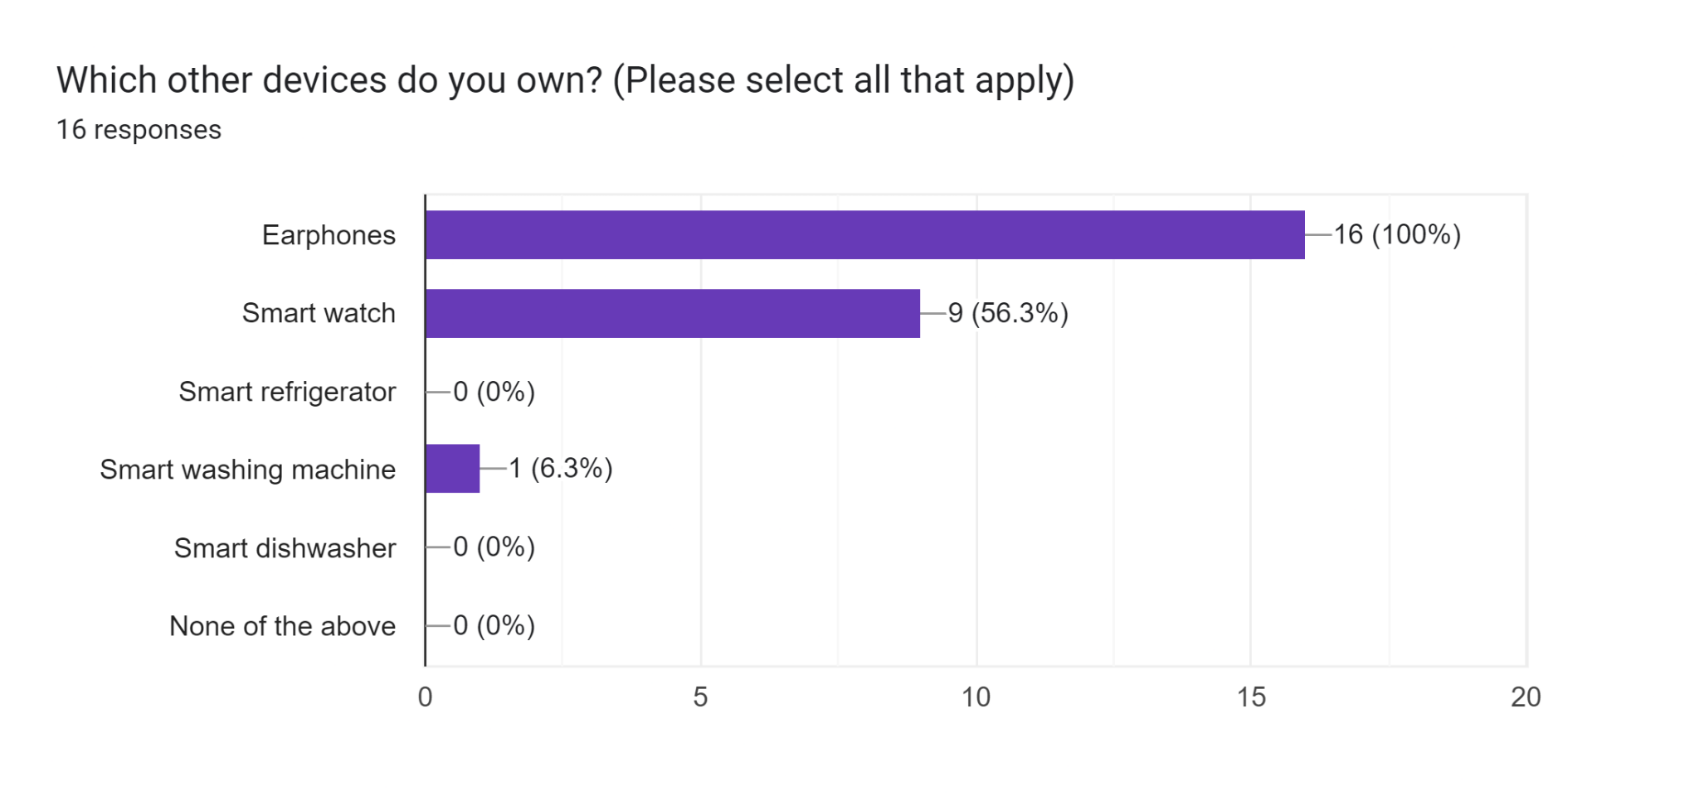

Slide 5
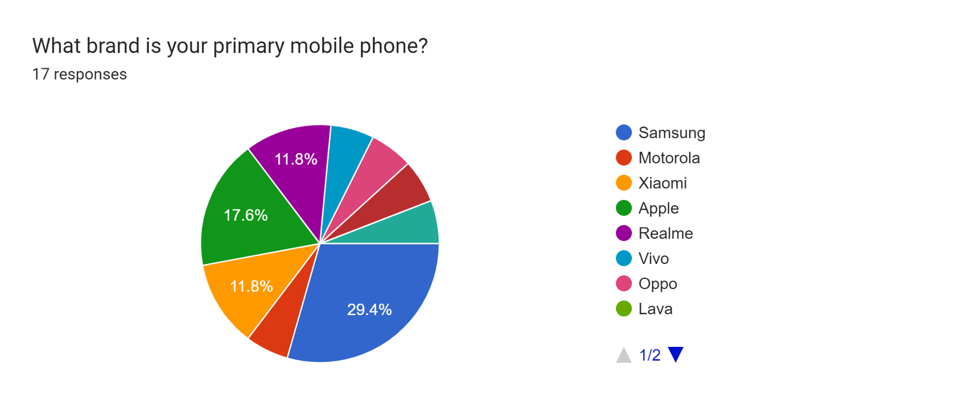
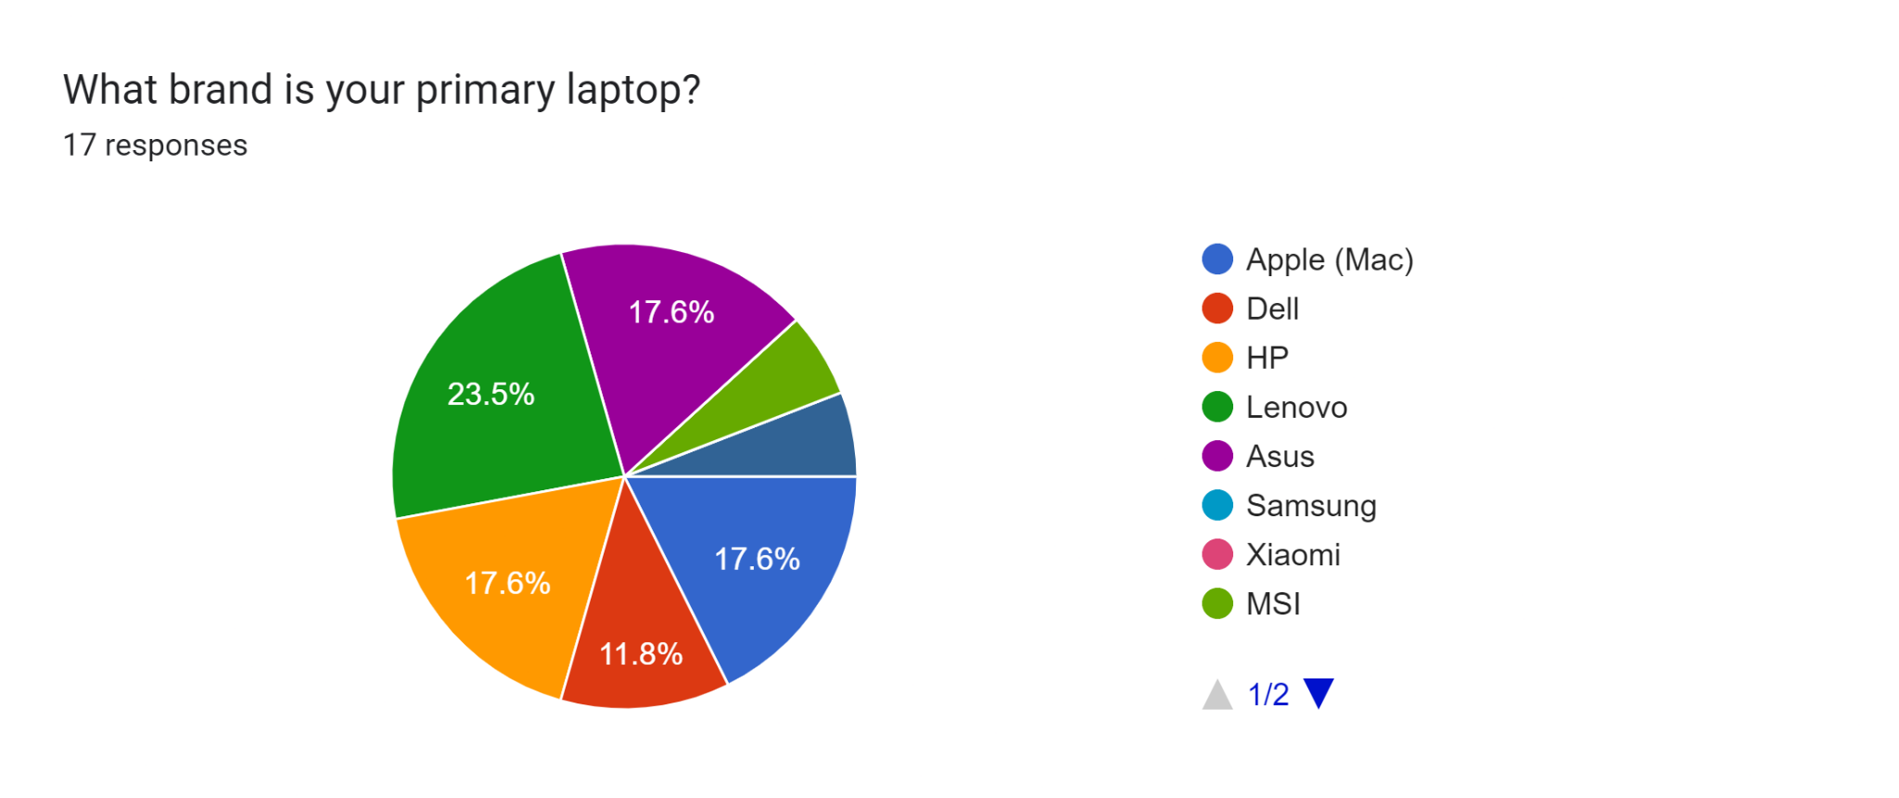

Slide 6
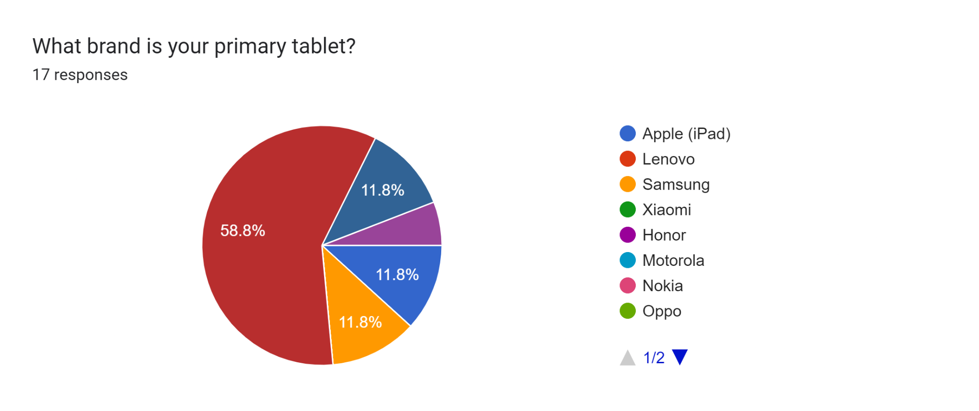
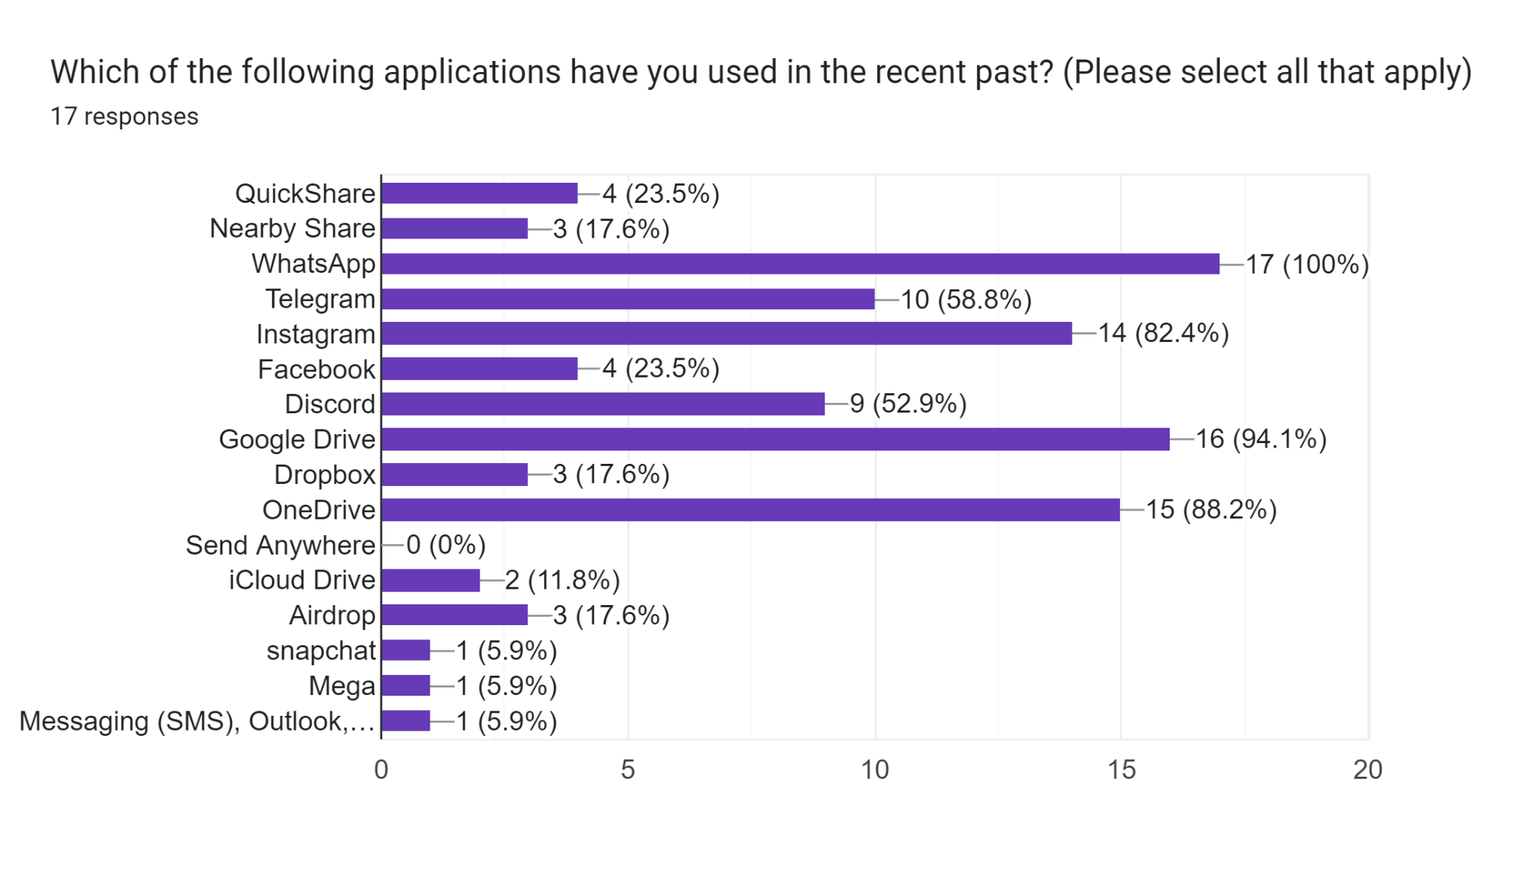

Slide 7
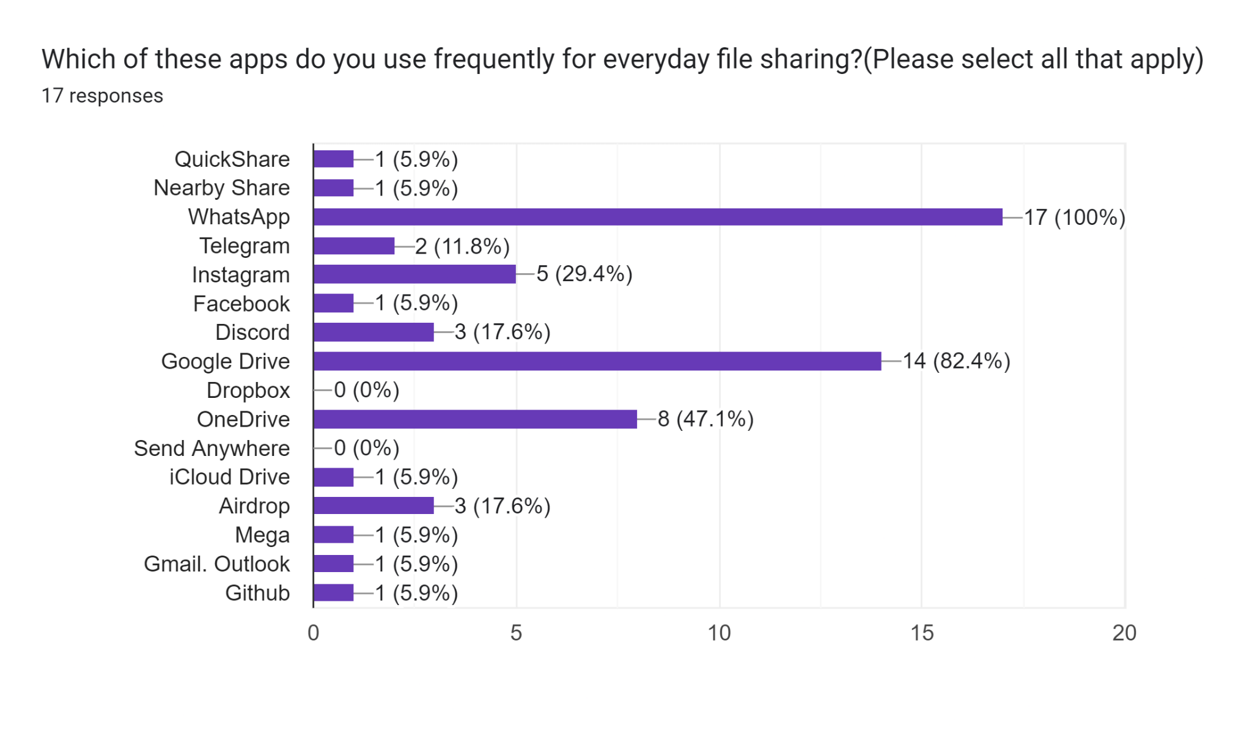
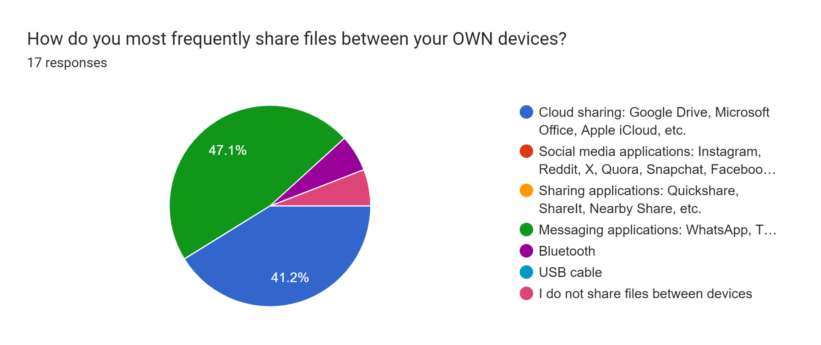

Slide 8
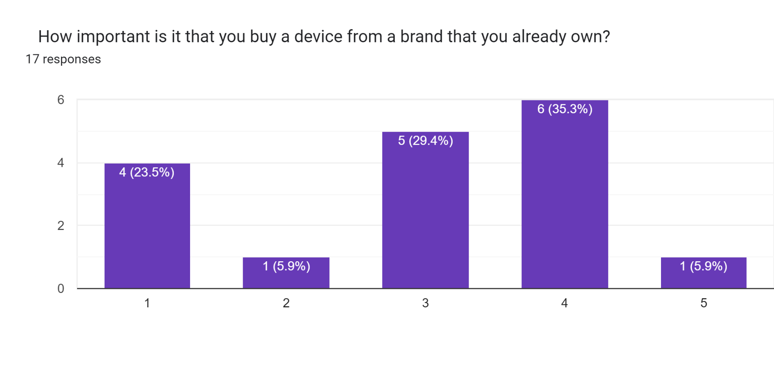
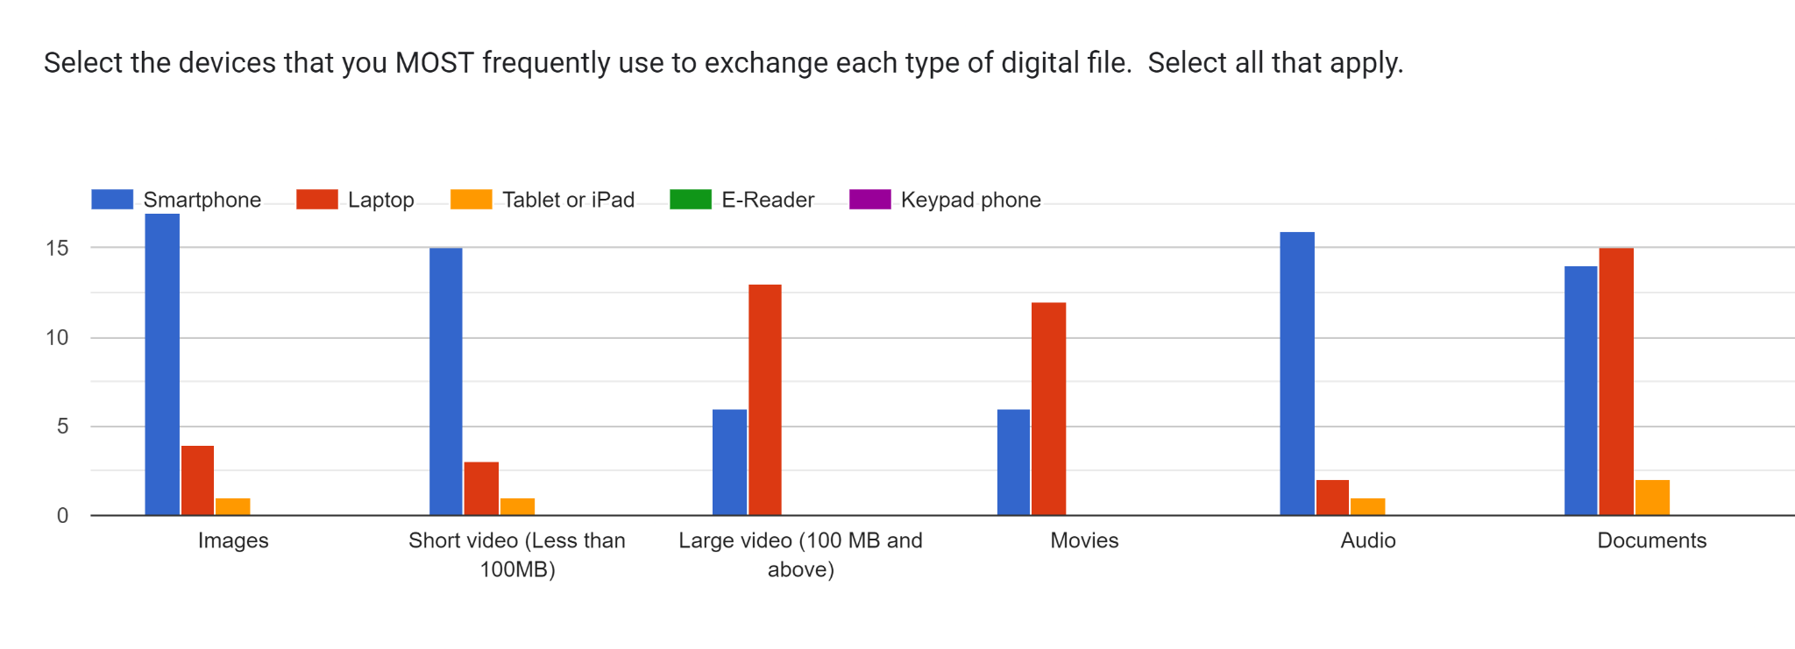
1 - Not important
5 - Very important

Slide 9


Sender’s Demographics
8
INTERVIEWS
75 %
25 %

Slide 10
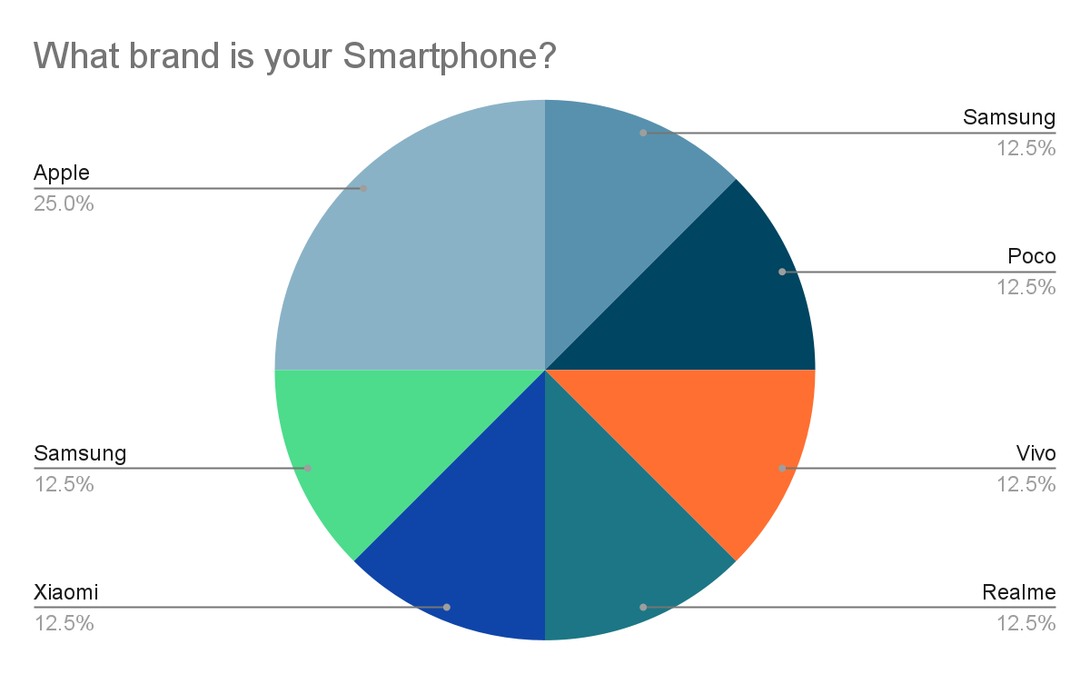
Sender’s Demographics
8
All participants own a smartphone and a laptop
2 of them had an Apple device
1 had a Samsung device.
1
Owned an Apple iPad
5
Had a smartwatch

Slide 11
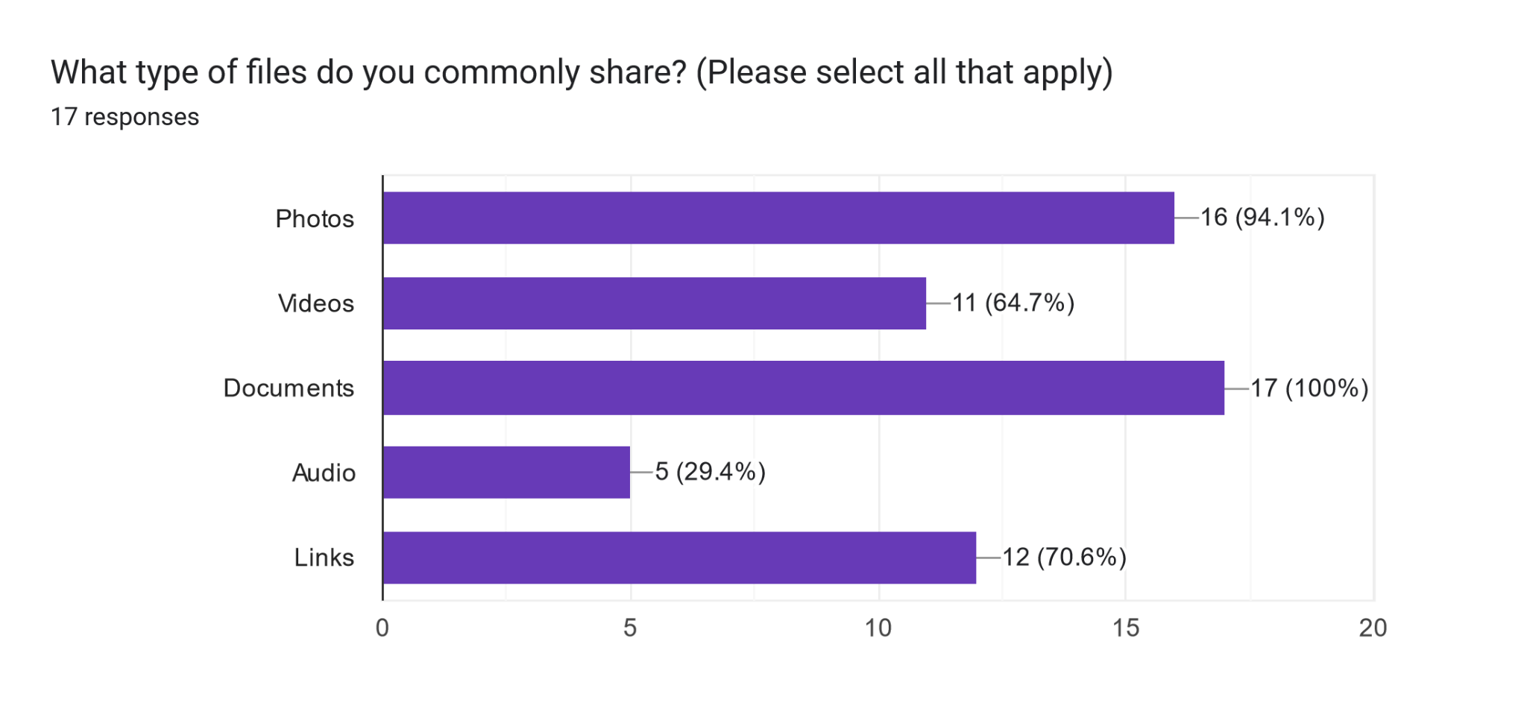
FILE TYPE
DOCUMENTS
”Some documents have to be shared like some passbook details or when my brother has booked my tickets.”
-P4.1(M.Sc DT Student,Motorola user)
"Like I took picture in my phone and then whatever I need I just copied the picture in from my device and I pasted the same picture in the Word document”
-P2.4(Msc. DT student,Apple user)
PICTURES
“In the last three days for the Infini8, we have photographs for different days, like day zero, day one, day two.”
-P4.4(M.Tech Student,Apple user)
“Okay then I can say that when we had the last week SIGCHI talk with Mr. Aditya from Uber, so we have taken the picture right,I used the AirDrop feature to get photo from that guy who took the picture"
-P2.4(Msc. DT student,Apple user)

Slide 12
“I used WhatsApp to transfer a file from my laptop to my phone for a computer science project two days ago”- P4.3(Xiaomi user)
“When I have to share the files between my own devices, I use AirDrop,it is very convenient”-P4.4(Apple user)
Interoperability(Own devices)
“So I have my laptop and my mobile. So between that I transfer to Google drive and from that I transfer my files to the laptop”-P2.1(Vivo User)
“All the data that I had in the old device which I had
to transfer in the new device,I did by using my Google account’s Drive"-P2.3(Samsung user)

Slide 13

“Whatsapp only,Most probably it would be Whatsapp .Documents like tickets, screenshots so these files can be shared through Whatsapp . It is very much handy"-P4.1
"We have a different WhatsApp group for different purposes. So we usually share files in that one." -P2.3
Mode:
Internet Based
Group
Sharing
"For a Quick note, it depends on the file type, I will share images on WhatsApp. If even a small document is there, I would prefer to share it
on WhatsApp"- P2.1
"If we have family, then what do we need, images or videos, mostly, then we can share them through WhatsApp. - P4.2
"If I have to send photos to multiple persons, then I think WhatsApp is pretty convenient for me"-P2.2

Slide 14
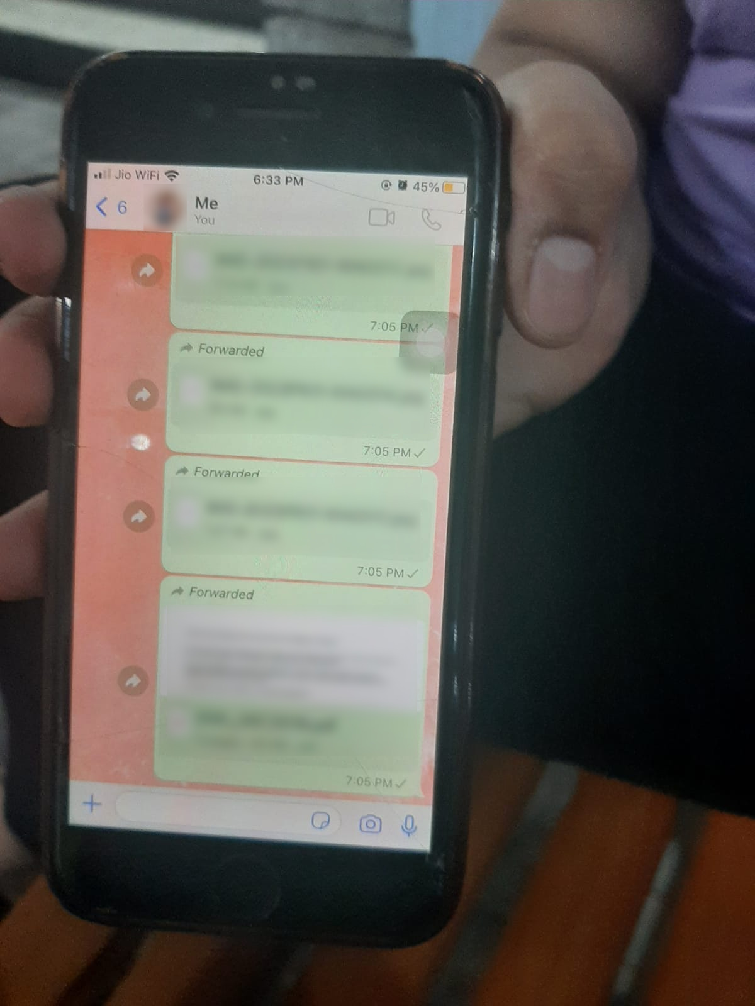
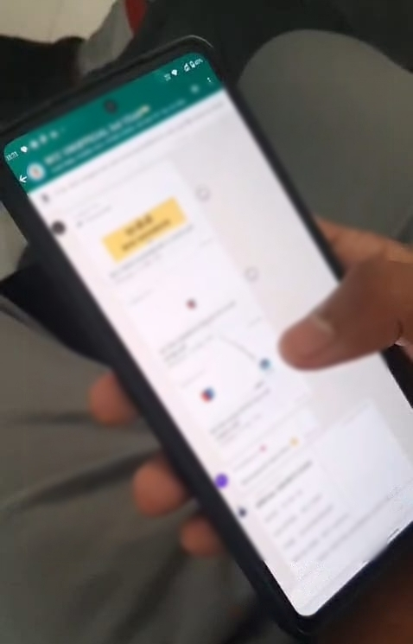
Fig 1 & 2 : Respondents using WhatsApp for sharing files

Slide 15
“I will wait for internet or if it's very urgent then I will ask the people nearby" -P4.1
"When having no access to internet ," I will send it later “ - P4.2
“I wait for some time to get access to mobile data or Wifi to share the files using Whatsapp “ - P4.4
“if I have a USB cable that I can connect to my phone. I also have a hard disk that I can use to connect to my mobile.” -P4.2
“Back when Shareit was available, I would use it a lot. It was a very good app, I miss it. No other app has been as good as Shareit " -P4.3
“I used Nearby share as it does not require internet, and it’s easy.” - P2.1
"My friend gave me a course or he downloaded the entire course and, I asked him to give it to me via his hard disk.” -P2.2
"Yeah, maybe the hard disk if I have large files and no internet. We can transfer using a hard disk." -P2.3
“I don't have Internet mobile data plan in my device and that region doesn't have the WiFi connection also. So now what I did is use the AirDrop feature to get photo from the that guy who take the picture" - P2.4
Mode:
Non-Internet Based

Slide 16
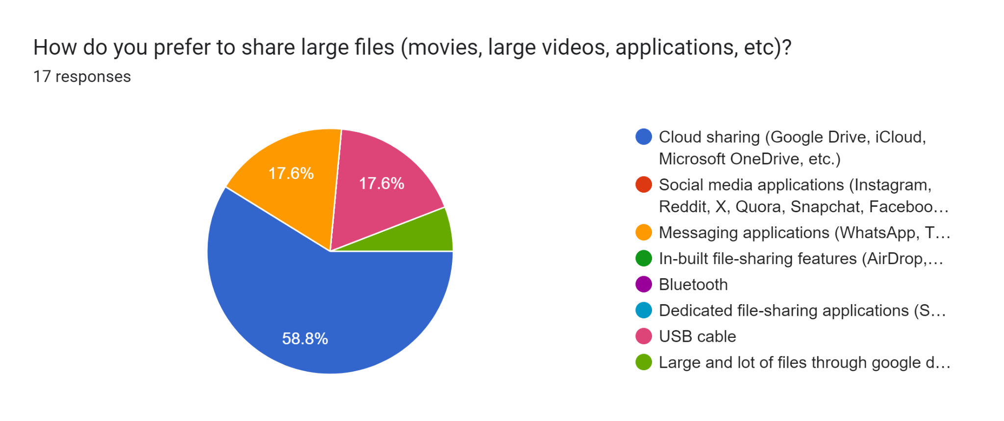
Large files sharing
"For large files,I used MEGA as it provides 20 GB of free storage" - P4.2
“For the videos, in WhatsApp, it is the concern. Otherwise, in Google Photos, we can just share bigger files as well” -P4.4
If many Images are there, I would make a pdf file out of it & share it via Cloud -P2.1
"I share some images and some documents for that also, I've never felt the need of using any other app other than WhatsApp ". "If it is some large file, then also like Google drive comes into play so we can share the link and they can access it" -P4.1
I shared large files using 'Google Drive’ -P2.4

Slide 17


“Basically when I'm working with my group, basically, uh, right now I am working with a group in my HAD project, so, uh, I generally use,, GitHub to send the file to multiple members.”- P2.2
“I started using discord in school when my gf asked me to start using it because she used to be online on it most of the time.. that's how our group also started using it”-P4.3
Real Time Sharing
“For projects we use GitHub. So it is because it's quite easy to share and manage within the group for coding ”-P4.4
“I used discord to share screens and used the common server feature to view movie together with friend sitting in different locations"-P4.4

Slide 18
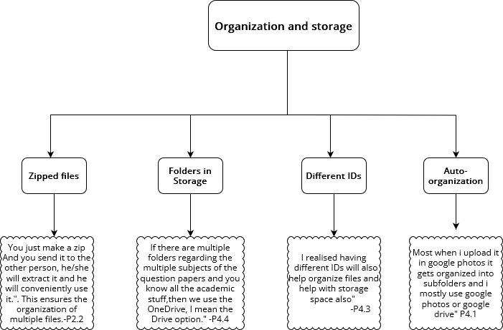

Slide 19
"Through WhatsApp ,Some time,some issue was there and so I was required to send some list ,so I went and viewed when did I send this list, and wanted to check if I had sent it or not."
"I access old WhatsApp chats to see what I have sent before if it's needed, and sometimes email."
P4.3
P4.1
History
P4.4
P4.2
“In WhatsApp For messages only, or for some links. Because if we want to check the documents we can just go and but if it is some important message like somebody has told me something to do so I think using the keywords we can just search the keyword and check it."
"I keep access to track files on OneDrive . And we tell them many times who has access to it.if someone is asking, we get a direct email on outlook. That is a very convenient option."

Slide 20
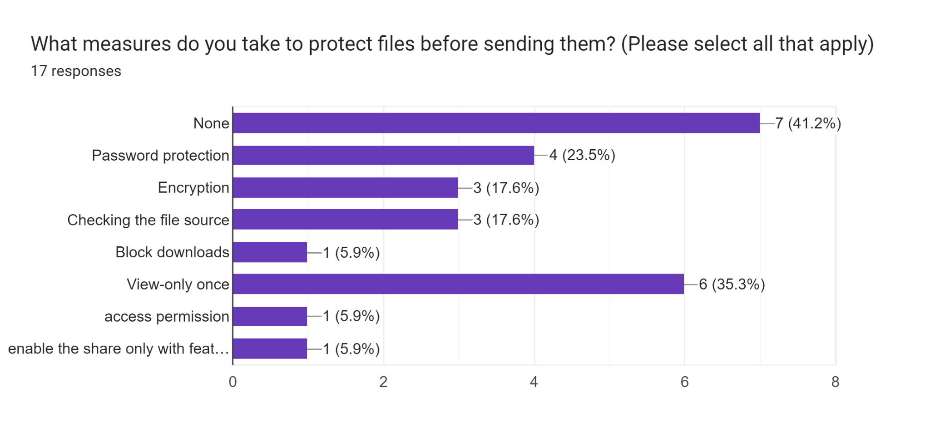
Security

Slide 21
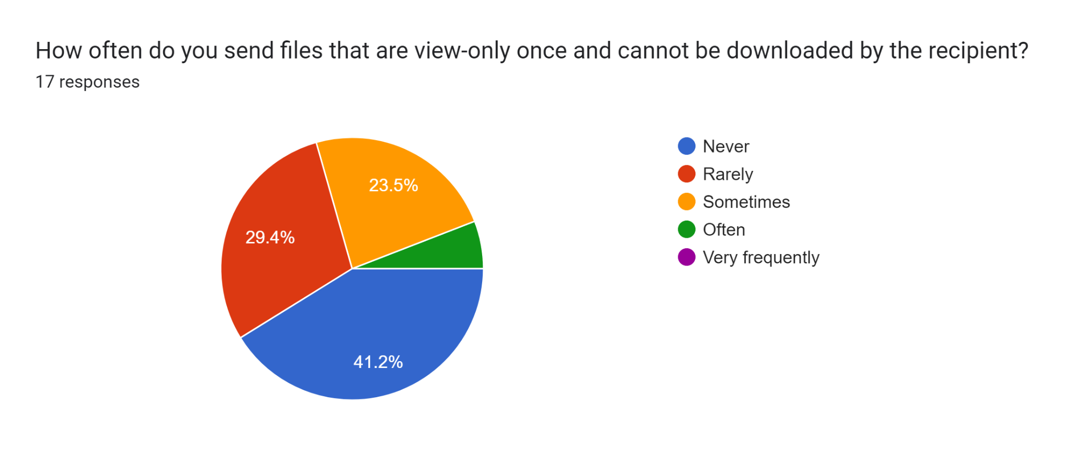
"One instance that I can remember is sharing a class assignment with a friend. I shared it on drive with view-only access, although if my friend can be trusted."- P2.1
"Mostly I have done this for the bank-related thing, if I want to share something to my parents, they are not so used to the email thing or anything like that, so I just click the pictures of some important documents and I send them with view only once option."-P4.4

Slide 22
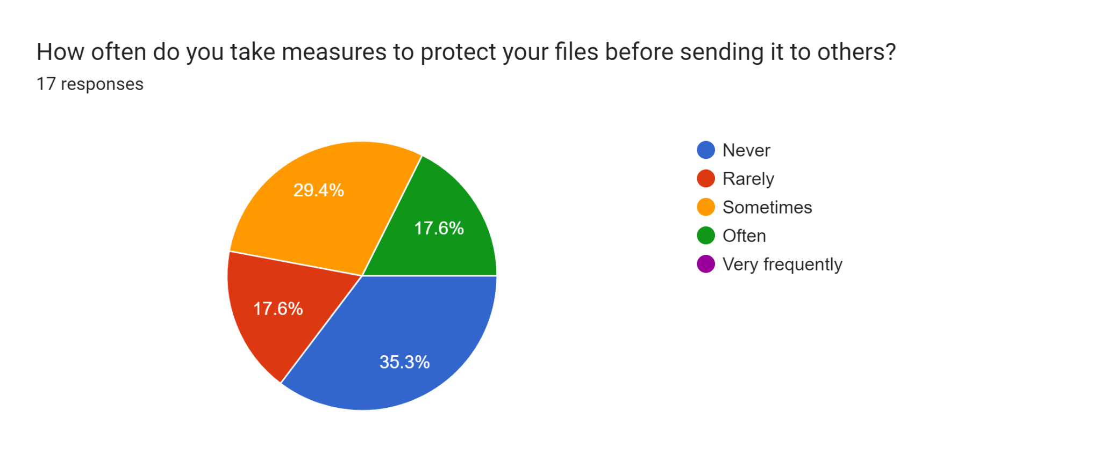
" I am not bothered about security issues while sharing files"- P2.3
"WhatsApp provides various internal mechanisms for encryption. Even if we are sending a photo over WhatsApp, it gets strictly encoded in binary, and after that it only goes to the receiver, and even WhatsApp management people cannot view the document unless they consult the security team. So WhatsApp is a pretty safe and efficient way for sending data."- P2.2

Slide 23
Privacy
"I usually preferred sharing through my email because of number concerns."-P4.4
"I would prefer to give my mail instead of phone number. I have two mail IDs, one being dummy, so I will prefer to share it with the receiver to protect in case of privacy."- P2.1
"Maybe something explicit photo. If we have to show to our friend in a way that he or she could not blackmail us again with that photo. So add that disappearing message, that one-time message. Maybe that case we can use."- P2.3
“Use of one-time viewing option for sensitive information”- P4.3
"I keep access to files on OneDrive . And we tell them many times who has access to it.if someone is asking, we get a direct email on outlook. That is a very convenient option."- P4.2

Slide 24
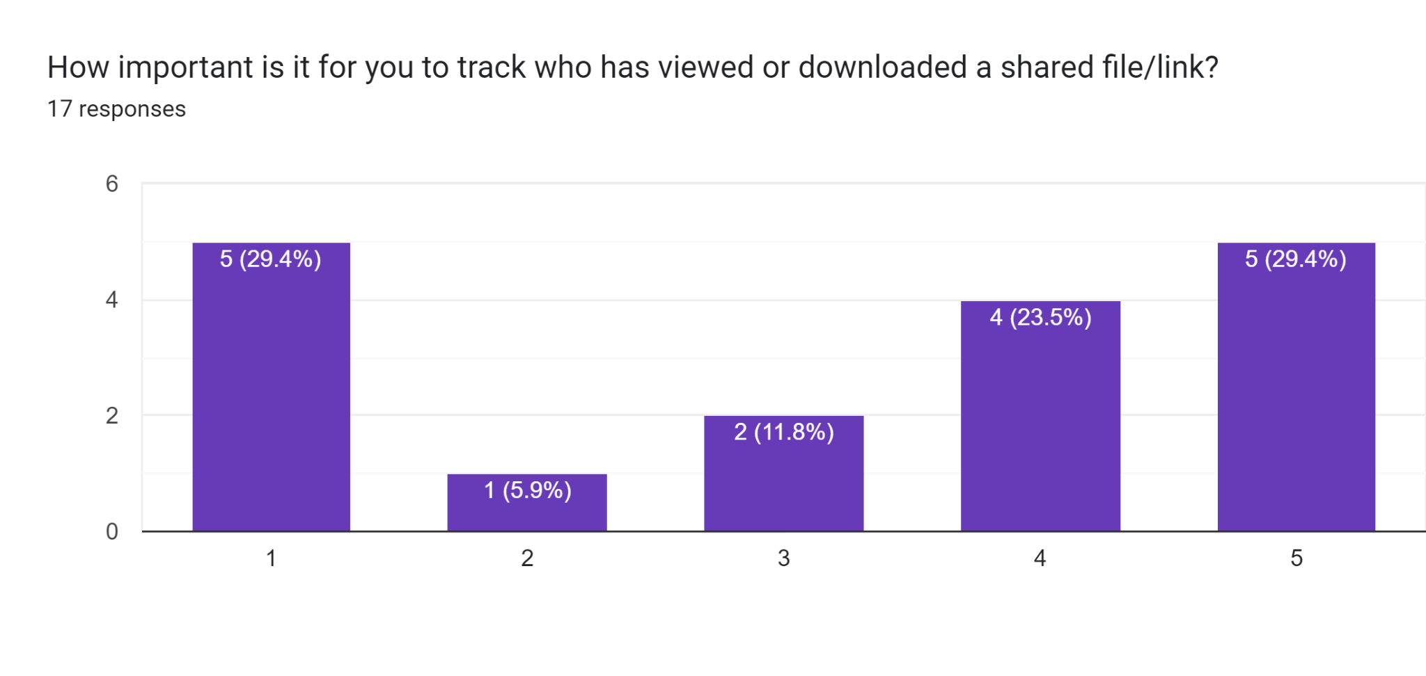
1 - Not important
5 - Very important

Slide 25
Urgency
"All my friends and family are on WhatsApp"- P4.1
" Most preferred is WhatsApp due to the ease of access and convenience” -P4.2
"If it's urgent - it's WhatsApp, always WhatsApp"- P4.3
" WhatsApp, I mean, this happens mostly with my parents. They use only WhatsApp."-P4.4
"On a Quick note, it depends on the file type, I will share images on WhatsApp. If even a small document is there, I would prefer to share it on WhatsApp."-P2.1
"Generally, in case of Emergency, I have sent small files and those small
files, I prefer to send it via WhatsApp."-P2.2
" So WhatsApp should allow more things. Yeah, more. So that while deadline is coming, so that we can send our assignments very fast and quickly. We can share them very quickly. In case of Urgency WhatsApp seems the most convenient.”- P2.3

Slide 26
Quality
"If quality is the concern for the notes,I share it as PDF. With respect to image sharing on WhatsApp,I find sharing it as "HD" quality very convenient”-P4.1
"Quality matters on the context,if the other person wants it in HD,then I send it over WhatsApp in HD"-P4.2
"I personally don't care about quality so much because anyway it's mostly fine but when I am sharing photos with friends, I send it in whatsapp HD, otherwise I don't bother"- P4.3
" It's just the quality that matters only when we have to share pictures or movie videos."-P4.4
"To send over WhatsApp(most of the time the receiver asks for images to be sent over WhatsApp), I create a document file, add the images in that file, and share it across WhatsApp. Otherwise, Cloud Storage is a preferred option."- P2.1
"Like for receiving any media files like images or videos. I used to prefer quality and in such case I will either ask them to share with me in airdrop or any other instant sharing like real time sharing. Otherwise I will ask them to upload in cloud and share it to me later when they have the proper Internet access."- P2.4

Slide 27
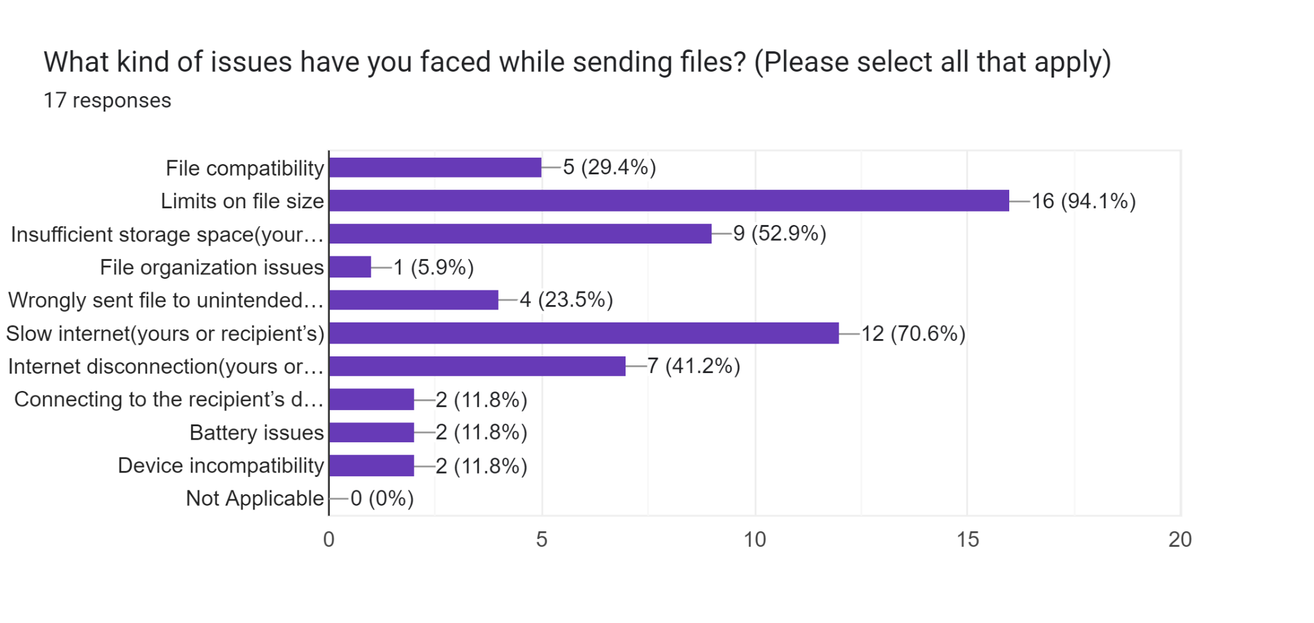
Error/Issues

Slide 28
"So I needed to share a file with receiver but what happened is my cloud storage is full so I can't able to upload the file and share with since the person is very remote and the file is also very large. So I need to clear my cloud storage and then I uploaded the same file and share it."- P2.1
"Many times,file sharing on WhatsApp goes wrong, like it does not get send. Due to some issues, probably network issues. So then we are required to share it again"- P4.1-
"I sent large attachments over email. This gets resolved by trying to send it for 2 to 3 times. I think there might be network problems, there might be algorithmic problems, there might be optimization problems, we are not knowing"- P2.2-
"Sometimes the Internet bandwidth might get reduced and the transfer might be stopped. Like for example once I shared a 2 GB file, so for the first few minutes I was in the app it so that time it was about 500 MB uploaded so and then for the next 10 minutes I close the app. The app was opened in the background. So when I came back to that app after 10 minutes the upload was has been paused. So some upload issues I have faced before".-P2.4-
-

Slide 29
Receiver's Demographics
9
INTERVIEWS
44.45 %
55.55 %

Slide 30
Receiver's Demographics
9
All participants own a Laptop and a Smartphone
2
4
Tablet Users
Smart Watch
1
E-Reader

Slide 31






INTERVIEWEE | MOBILE BRAND
P(1.1) | Samsung
P(1.2) | One Plus
P(1.3) | Samsung
P(1.4) | Samsung
P(1.5) | Xiaomi
P(3.1) | OPPO
P(3.2) | RealMe
P(3.3) | Samsung
P(3.4) | Apple
4 out of 9 participants are Samsung users

Slide 32
People and Context
WhatsApp is generally used as the primary mode of communication between academic groups.
Files for viewing are send on WhatsApp
Files for working are send over MS Outlook (Email) or GitHub
Samsung S7, High School Student
WhatsApp is a means of communication between classmates, teachers, and parents. Used to get school updates, late submission reminders, exchange doubts and questions, etc.
P1.3
Samsung user, Student
We send .py files through Github or Outlook because on our phone its useless.
P1.4
Samsung user, Student
If I need to see notes for some class I missed I asked them from my classmate on WhatsApp
P1.4

Slide 33
People and Context
In social settings photos that are transferred need to be of good quality and with ease.
Among friends, photos, videos are best shared over AirDrop or iMessage as files are automatically saved in the gallery. No deliberate organization is required. Quality is retained.
iPhone user,
working professional
P3.4
Xiaomi phone user, student
For pictures that I click with my friends I prefer to receive it through Telegram
P1.5
Telegram preferred for friends only.
Samsung phone user, student
P1.1
After an outing if we have clicked picture my friends and I share and receive it on Telegram

Slide 34
Interoperability
Web versions of messaging applications seem to be the most popular for inter-device file sharing (WhatsApp Web, Telegram Web, etc.)
iPhone user,
working professional
P3.4
Files transferred from personal to work account, personal device to work laptop
RealMe user, student
P3.2
Files transferred from phone to laptop for better visibility
Samsung phone and Mac laptop user, Student
I dont transfer files from device-to-device, since I gets files only from online sources, which I can access form both my laptop and my phone.
P1.4

Slide 35
Internet Absence
Internet availability is not a concern. If wifi is not available then mobile data is used.
Samsung user, Student
Now the places I have travelled to all have decent internet connectivity so not exactly an issue
P1.4
Bluetooth is used in few cases but not appreciated.
Oppo user,
student
P3.1
Used Bluetooth for sharing, but takes a very long time.
Samsung user, Student
P1.4
Bluetooth is very exhausting, it takes hours to get a video.

Slide 36
Group Sharing and Bulk Sharing
Communication back to the sender is less-frequent in case of receiving in a group. Simple acknowledgements through reactions are likely to be more common.
Samsung S7, High School Student
If it’s one-to-one, then definitely response matters. If it’s in a group, then I don’t know - I’m not as likely or inclined to send a reply...it’s because one-to-one they’re speaking to you directly, whereas in a group it’s not like you have to respond. It’s not a necessity.
P1.3
Google Photos links are a convenient way to share multiple images.
iPhone user,
working professional
RealMe user,
student
P3.4
P3.2
Multiple images are sent via Google Photos link

Slide 37
Group Sharing and Bulk Sharing
Google Drive is a common tool for sharing files, but managing access can be cumbersome.
Samsung user, Student
Google Drive is also fine, but then you have to provide access to your drive or where you upload the material. So, sometimes that can be a bit of a hectic task because you need to know everyone's email IDs
P1.4
Xiaomi phone user, student
Giving access to Drive folders is an extra step, we often forget it.
P1.5

Slide 38
Group Sharing and Bulk Sharing
Samsung phone user, student
Receiving images as a group after an outing is a fun, collaborative event. Images are usually shared after the outing and not during. In case of students on campus, this is because they have access to campus wifi and would rather use that over their mobile data.
P1.1
iPhone user,
working professional
P3.4
Files are mostly shared (including bulk sharing) through company’s intranet chat app – channels are created for smaller teams/groups

Slide 39
Specific Application
RealMe user,
student
Watch Specific
File Sharing
P 3.2
Data sharing like the data get collected on the watch, i transfer to my phone. Using Noisefit application.
Discord preference over WhatsApp and vice versa
Samsung S7, High School Student
P1.3
Discord is preferred in the case of fewer files to be seen or downloaded.
Samsung S7, High School Student
P1.3
WhatsApp preferred over Discord in case there are many images to be seen, since they all get directly downloaded into the gallery.

Slide 40
Organisation and Storage
Organising in Cloud is a tedious task but is also used on multiple devices.
And the thing is, with platforms like this (cloud), you can have specific folders, like if I receive just for yesterday, I can make a folder of yesterday's date.
But if I get it to my phone, there will be a lot of another media also that I will receive through other contacts. Those will be also stored in the same date and when I have to go through all the photos, I'll have to select each one of them which is related to this or not. And going through that is a tedious work.
Samsung user, Student
P1.4
RealMe user,
student
P3.2
Cloud storage, I use when I have to view it using laptop as well or when I have to view it from multiple devices.
Respondents had different ways of dealing with device storage: P1.3 makes sure to go through old files when 'bored' and delete the ones not necessary. P1.5 sorts out all files on his phone at the end of the semester, transfers the files he needs onto his laptop and deletes the rest.

Slide 41
Organisation and Storage
Web application, BackUp options, and Extra cloud storage is purchased to facilitate storage issues
Samsung phone user, student
P1.1
Telegram Web is used to view all images first before downloading them, to avoid clogging up device storage.
Oppo user,
student
P3.1
Clear storage, delete screenshots and large files (according to Google Photos utilities) to make space.
P3.4
Google Workspace paid plan is available at the workplace, files are shared in that ecosystem
iPhone user,
working professional
P3.4
Backup photos to Google Photos. Purchased extra cloud storage – Google One annual plan

Slide 42
Quality
Alternatives to WhatsApp are used like Telegram, Google Drive, and Google Photos in case for high resolution
Oppo user,
student &
Samsung user, student
P3.1 & P3.3
Some are unaware or unconcerned about quality reduction while sending media over WhatsApp
Samsung & Xiaomi phone users, student
P1.1 & P1.5
WhatsApp is generally not preferred for high-quality images. High-quality images could be: images for wallpapers that others post or images to be posted on Instagram or other generally appealing pictures to be stored
Samsung S7, Student
P1.3
If it’s screenshots, images, memes, or something, it’s probably Discord or WhatsApp. But if it’s a photograph and I need a high-quality resolution, then it’s Google Drive.

Slide 43
Privacy and Security
Privacy and Security is not a concern because the various other applications,chat locks, spam and block options.
"Like, I have a screenshot of some of the conversations I had with my friends and I've stored in a password folder that sometimes I also forget that what's there, so... It's hidden in plain sight but it's effective"
P1.5
Xiaomi user,
student
P1.5
“All irrelevant mails and files goes into SPAM”
I can use Telegram or maybe I can share him my email ID.
Samsung user,
student
P3.3

Slide 44
One Time View
Preference and context of One Time View varies among different participants.
Oppo user,
student
P3.1
Don’t prefer one-time view files – if unanticipated, I don’t get to see them again.
One-time view images are convenient; in messaging platforms, the UI feels very bulky if we send images back and forth which we don’t intend to save.
P3.4
iPhone user,
working professional
These photos are usually circulated in the class group where it's a photo that is not very good, but still can be very funny. So, sometimes people try to send that photo through a view once only.
Samsung user, Student
P1.4

Slide 45
Errors/Hassles
Range of error from Software issues to picture resolution
P1.4
Different softwares on sending and receiving devices can lead to compatibility issues. For example, if someone sends a Microsoft 21 version PPT file, and the receiver has only Microsoft 16, they may not be able to access the file in the same way.
Samsung user, Student
One plus user,
Student
P1.2
Slow internet connectivity can make it hard to get or download files sometimes.
Samsung user, Student
P1.4
People sometimes forget to give access and it becomes a long process
RealMe user,
student
P3.2
Quality gets reduced, file size is very big and there is internet issue so it take long to receive

Slide 46
Urgency
In case of urgency preference is always WhatsApp
Samsung user, Student
Preference is always WhatsApp. But for them to send it immediately, I would have to call them up several times and ask them to send it. Rather than that, actually, it depends on the format of the file. Most probably, if I'm... If it's urgent, I would just have my phone and working on something. So, I'll like say to send through WhatsApp only. But if it's... Like it was in... Like I said, a code we have to forward. I would prefer GitHub because it is easier to access that if you have a repository.
P1.4
P3.4, P3.1
Prefer direct messaging via WhatsApp for urgent messages (P3.1, P3.4)
iPhone user,
working professional
Oppo user,
student

Slide 47
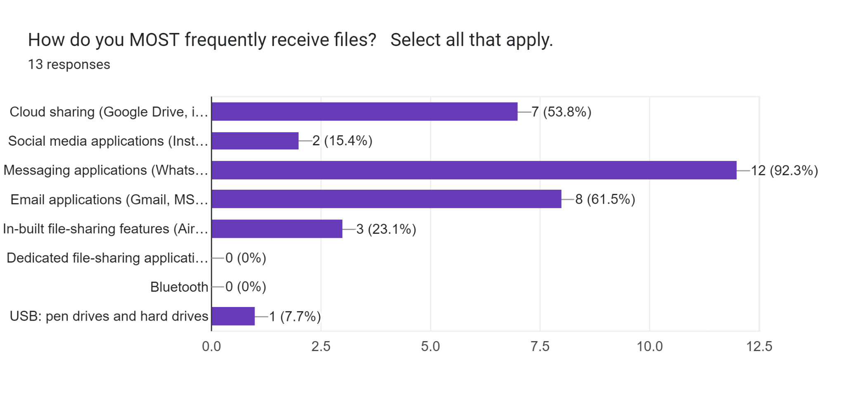
Most frequently receiving mode
Messaging applications are more convenient, everybody uses them (P3.2)

Slide 48
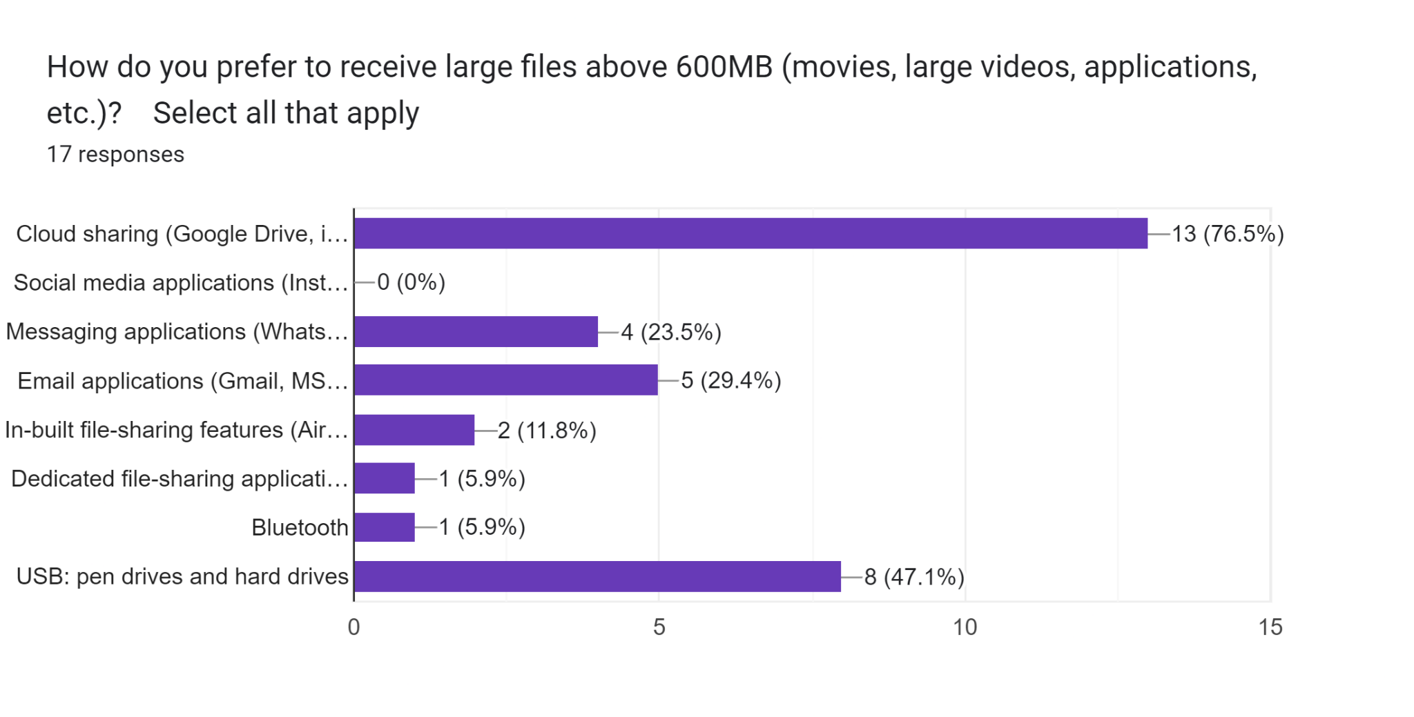
Large file receiving mode
Prefer using cloud link in case of large files (P3.1)
WhatsApp and Discord preferred for smaller files, Google Drive preferred for larger ones. P1.3

Slide 49
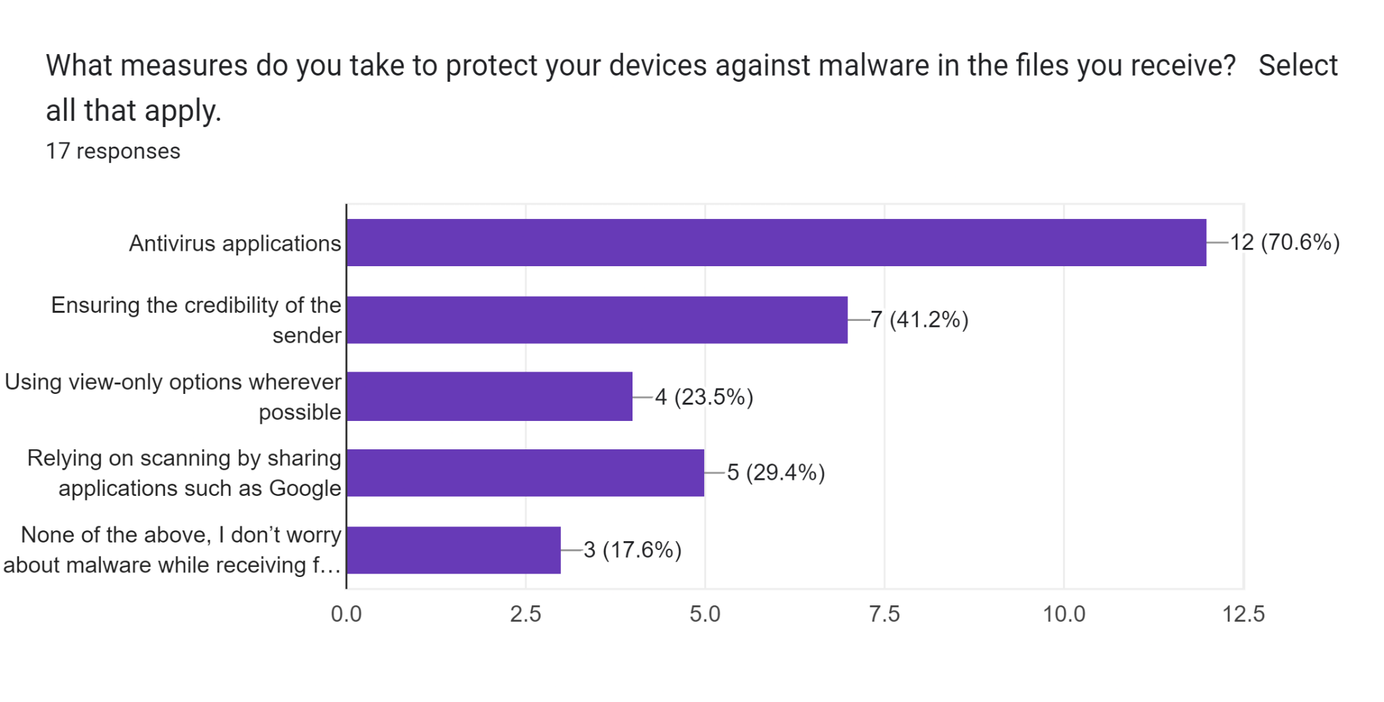
Measures taken to protect device from malware
Rely on antivirus apps, Gmail’s virus scanning feature for security (P3.4)

Slide 50
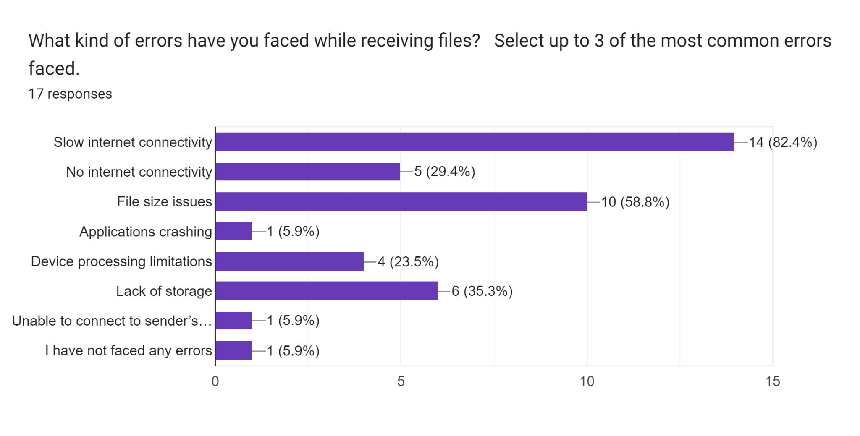
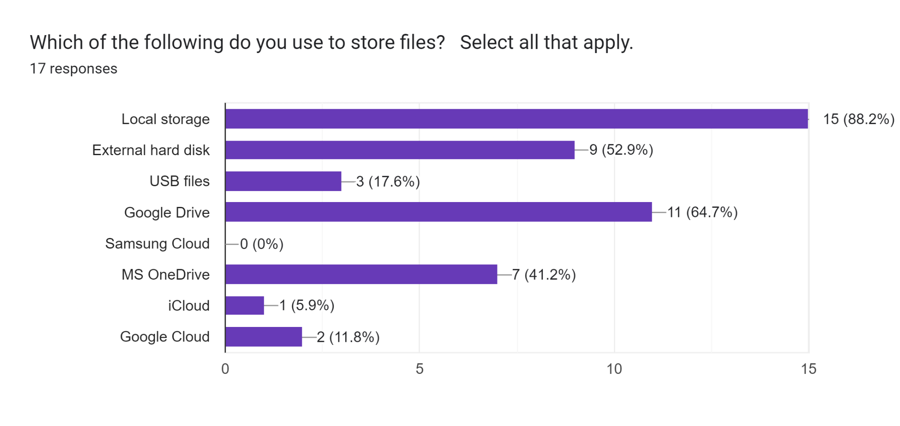
Errors faced while receiving mode
File Storage Habit

Slide 51
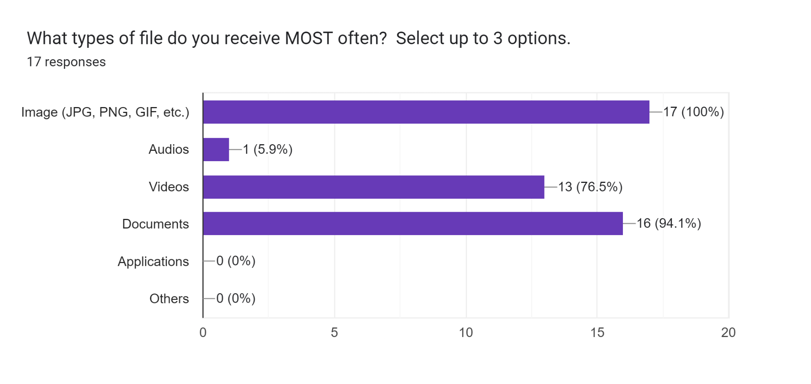
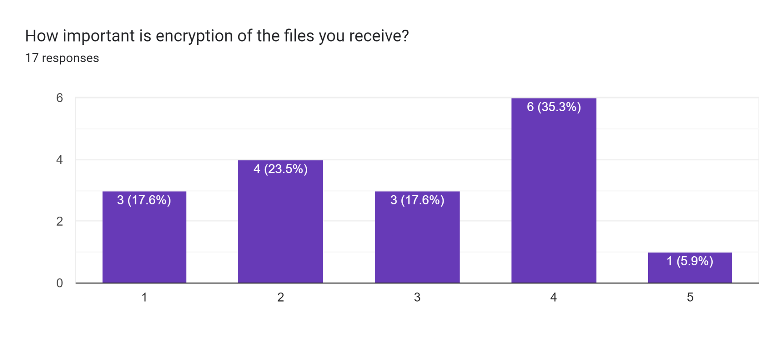
Type of file recieved
Encryption of file recieved
1 - Not important
5 - Very important

Slide 52
Thank You!

